Slide 1

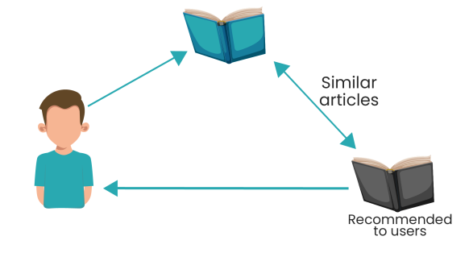
Text Similarity in Related Articles
Presentor By: Senghour Mey
@Pathmazing, GIA Tower level 39

Slide 2
What is Text Similarity?

Slide 3
Introduction
Text similarity is comparing texts and determining how close they are semantically.
There are some techniques in text similarity:
Term Frequency-Inverse Document Frequency (TF-IDF)
Word Embeddings - word2vector
Bag-of-Words (BoW)
Notes:
TF-IDF (Term Frequency-Inverse Document Frequency): Weight the importance of each word in a document relative to its frequency in the entire corpus.
Word Embeddings: Use pre-trained word embeddings like Word2Vec, GloVe, or FastText to represent words as dense vectors.
Bag-of-Words (BoW): Represent each document as a vector of word counts or frequencies.

Slide 4
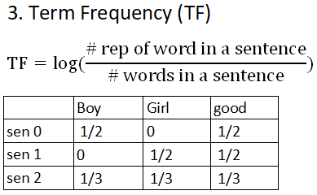
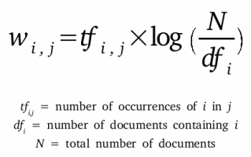
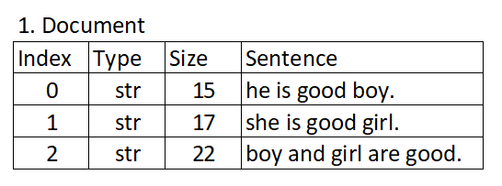
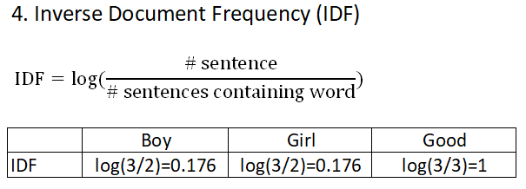
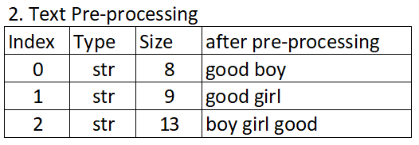
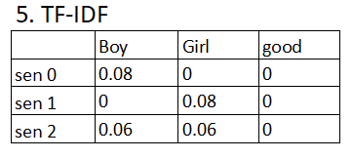
Algorithm 1: TF-IDF
TF-IDF:
Notes:
TF is the frequency of any “term” in a given “document”.
IDF is constant per corpus, and accounts for the ratio of documents that include that specific “term”.
statistical method in natural language processing and information retrieval. It measures how important a term is within a document relative to a collection of documents

Slide 5
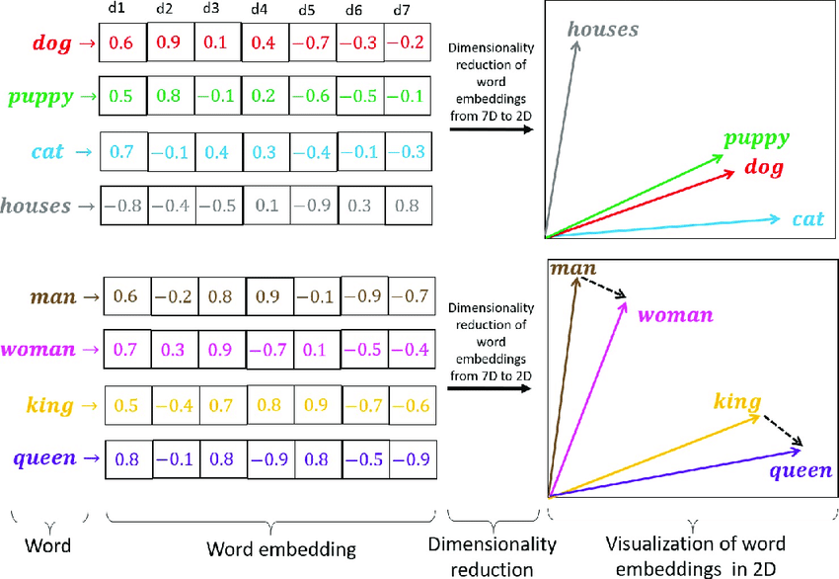
Algorithm 2: word2vector
Word2Vec is a model to form / create word Embeddings. Its a modern way of representing Word , wherein each word is represented by a vector (Array of numbers based on Embedding Size).
Notes:
Word2vec represents a word as a high-dimension vector of numbers which capture relationships between words

Slide 6
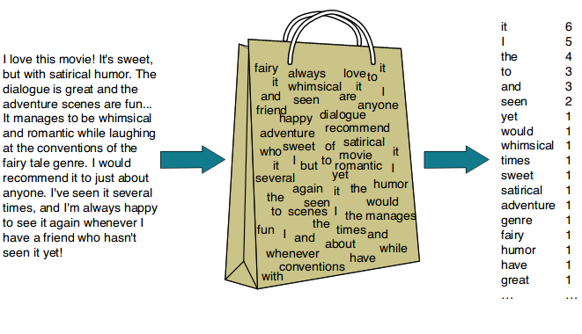
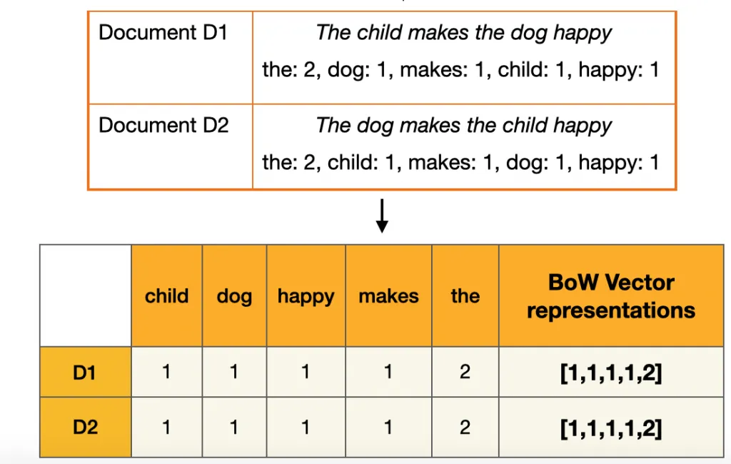
Algorithm 3: Bag of word
The bag-of-words model is a model of text which uses a representation of text that is based on an unordered collection (or "bag") of words. It is used in natural language processing and information retrieval (IR).

Slide 7
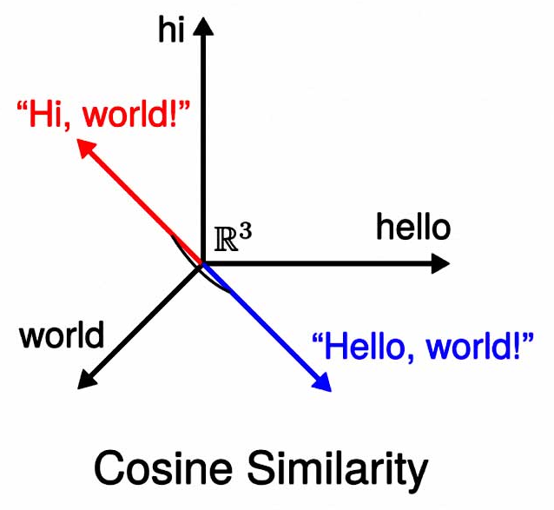
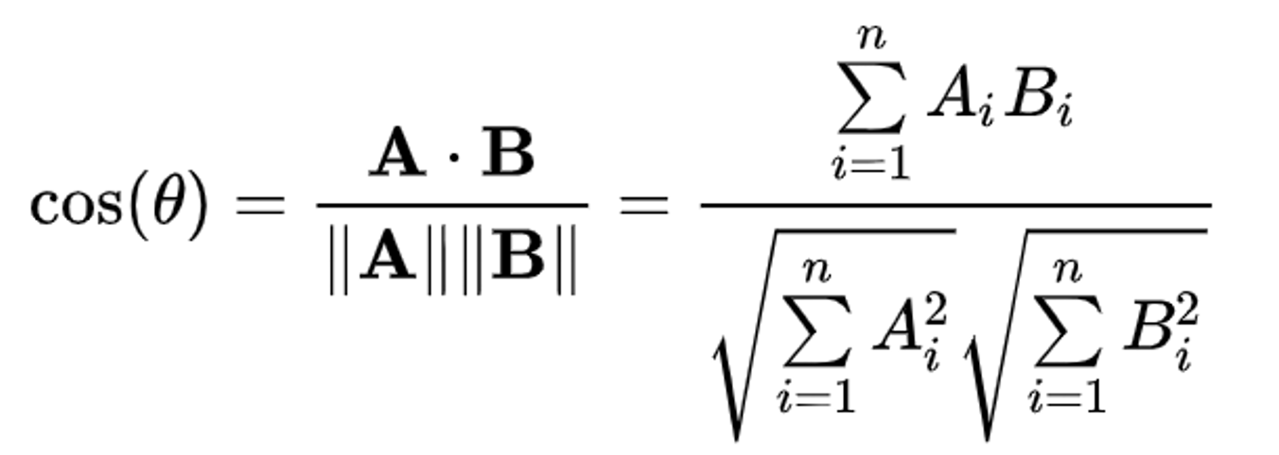
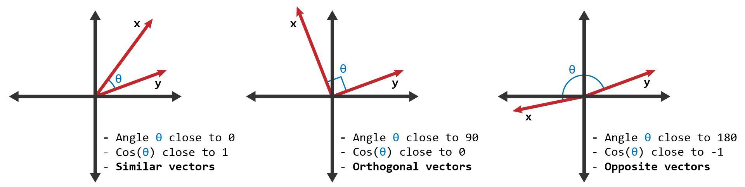
Cosine Similarity
Cosine Similarity is a measure used to determine the similarity between two vectors in a multi-dimensional space. It calculates the cosine of the angle between the vectors, where a value of 1 indicates that similar vectors, 0 indicates orthogonality (no similarity), and -1 indicates opposite vectors.

Slide 8
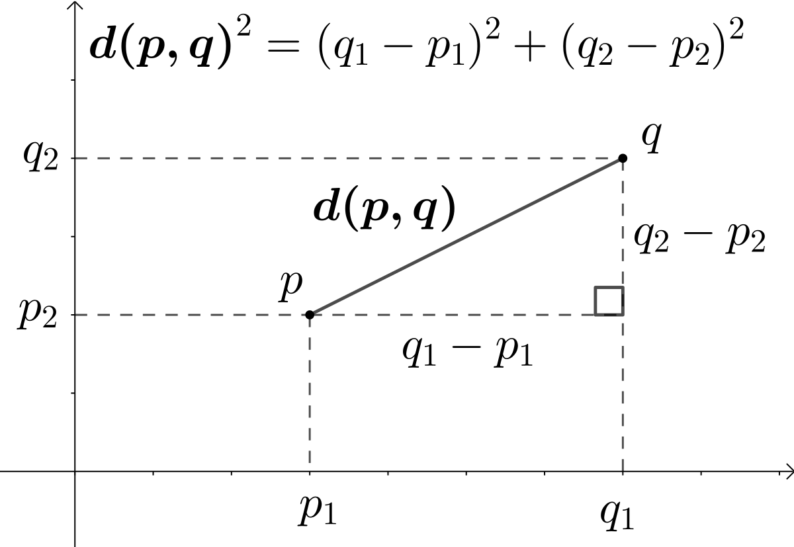
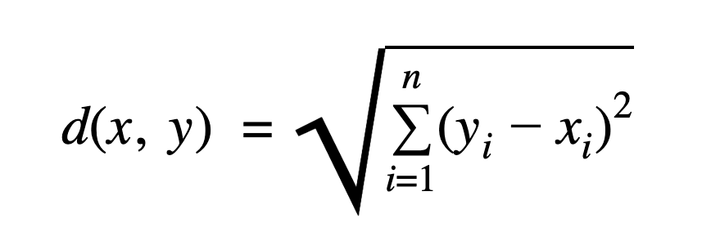
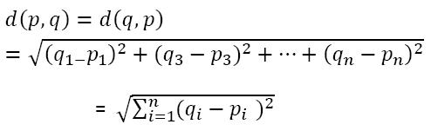
Euclidean Distance
The Euclidean distance formula is used to find the distance between two points on a plane. A straight-line distance between two points in n-dimensional space.

Slide 9
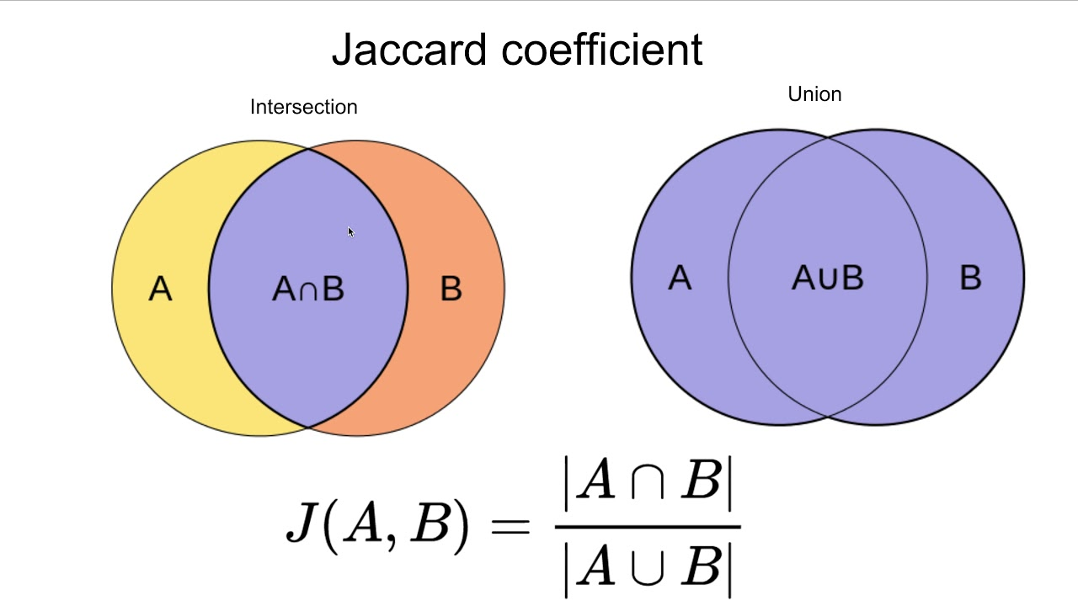
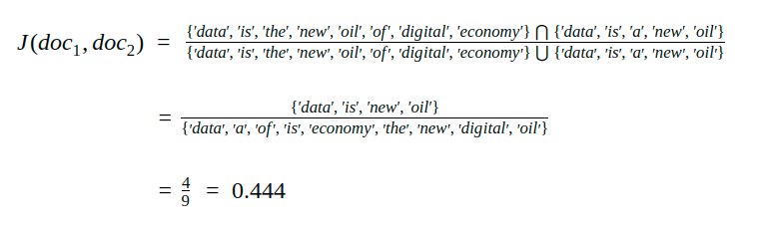
Jaccard similarity
Jaccard similarity coefficient, is a statistic used for gauging the similarity and diversity of sample sets.
Doc1: data is the new oil of digital economy.
Doc2: data is a new oil.

Slide 10
Flowchart of IF-IDF Algorithm
Load Data
Input Article
Load Model Spacy
Data Pre-processing
Combine Data Pre-Processing
TF-IDF Vectorization
Recommended to users
Output Similarity Article
Sort similarity scores
Calculate similarity matrix

Slide 11
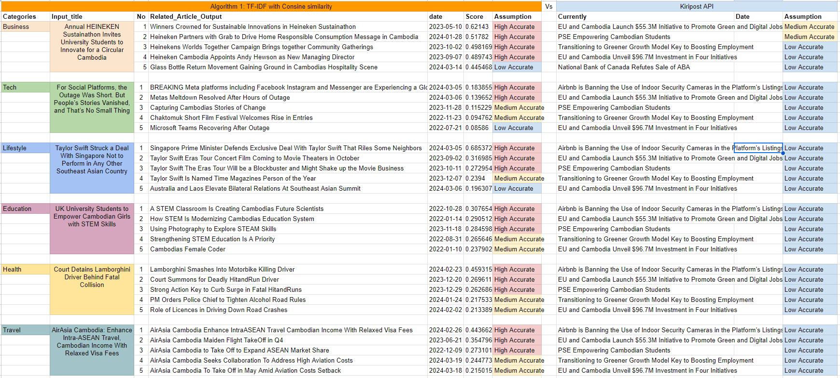
Result 1.1 of TF-IDF with Cosine similarity
Recommended
High Accurate: 18, Medium Accurate: 9, Low Accuracy: 3

Slide 12
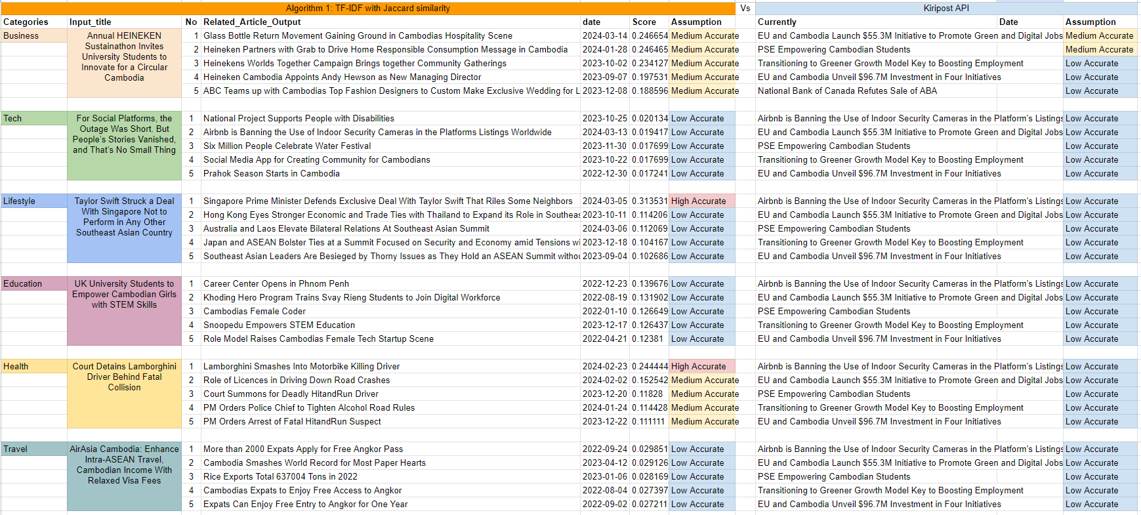
Result 1.2 of TF-IDF with Jaccard similarity
High Accurate: 2, Medium Accurate: 9, Low Accuracy: 19

Slide 13
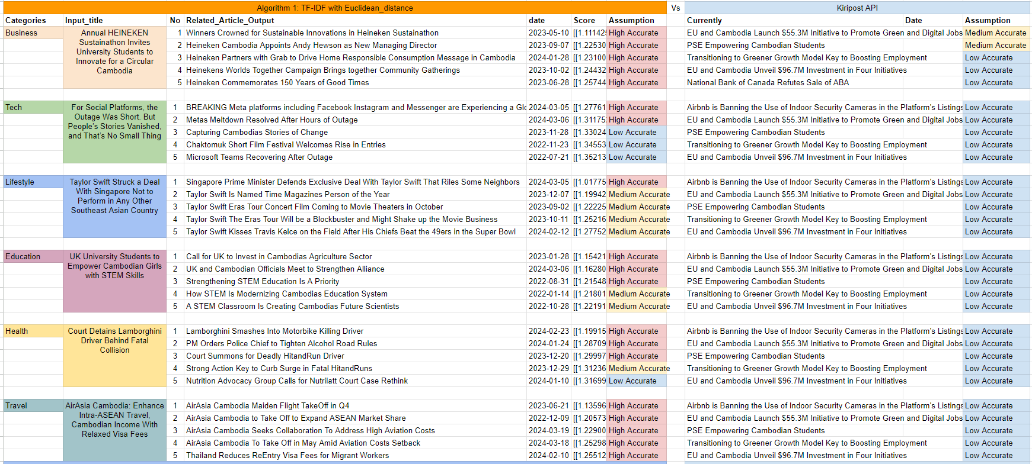
Result 1.3 of TF-IDF with Euclidean distance
High Accurate: 19, Medium Accurate: 7, Low Accuracy: 4

Slide 14
2. Flowchart of word2vector Algorithm
Load Data
Input Article
Load Model Spacy
Data Pre-processing
Combine Data Pre-Processing
Load word2vector model
tokens to word vectors
Output Similarity Article
Sort similarity scores
Calculate similarity matrix
Recommended to users
Notes:
spaCy model for English language processing

Slide 15
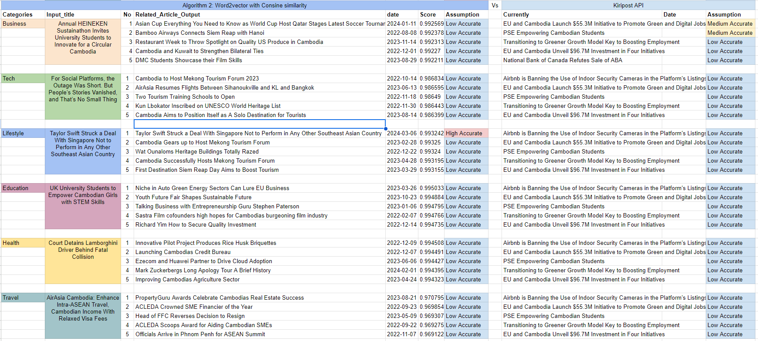
Result 2.1 of Word2vector with Cosine similarity
High Accurate: 1, Medium Accurate: 0, Low Accuracy: 29

Slide 16
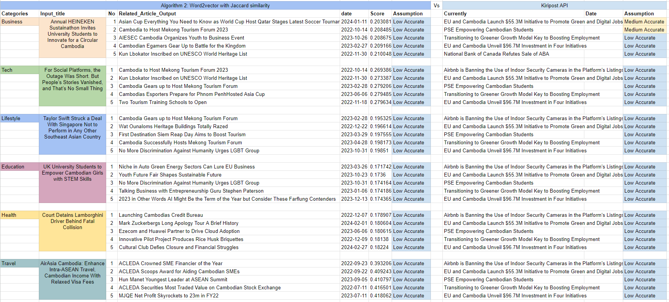
Result 2.2 of Word2vector with Jaccard similarity
High Accurate: 0, Medium Accurate: 0, Low Accuracy: 30

Slide 17
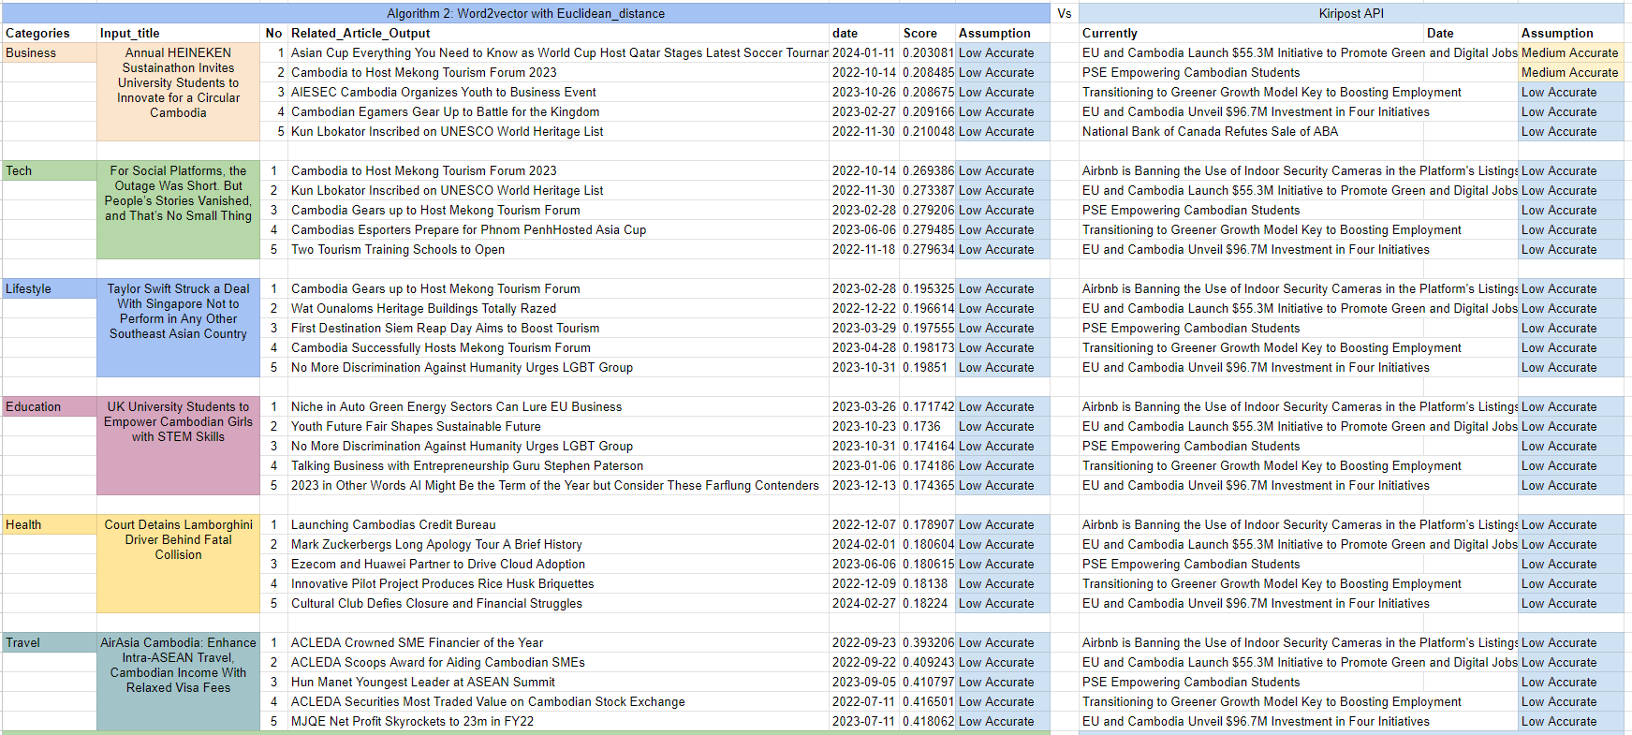
Result 2.3 of Word2vector with Euclidean distance
High Accurate: 0, Medium Accurate: 0, Low Accuracy: 30

Slide 18
3. Flowchart of BoW Algorithm
Load Data
Input Article
Load Model Spacy
Data Pre-processing
Combine Data Pre-Processing
BoW CountVectorizer
Output Similarity Article
Sort similarity scores
Calculate similarity matrix
Recommended to users

Slide 19
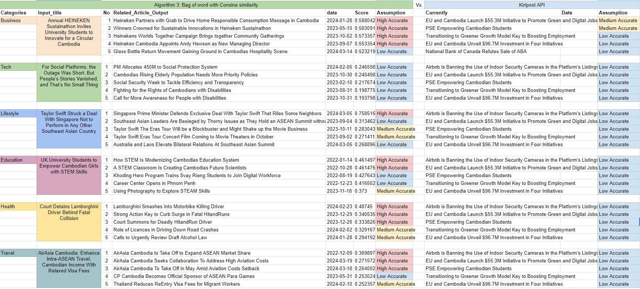
Result 3.1 of Bag of word with Cosine similarity
High Accurate: 13, Medium Accurate: 6, Low Accuracy: 11

Slide 20
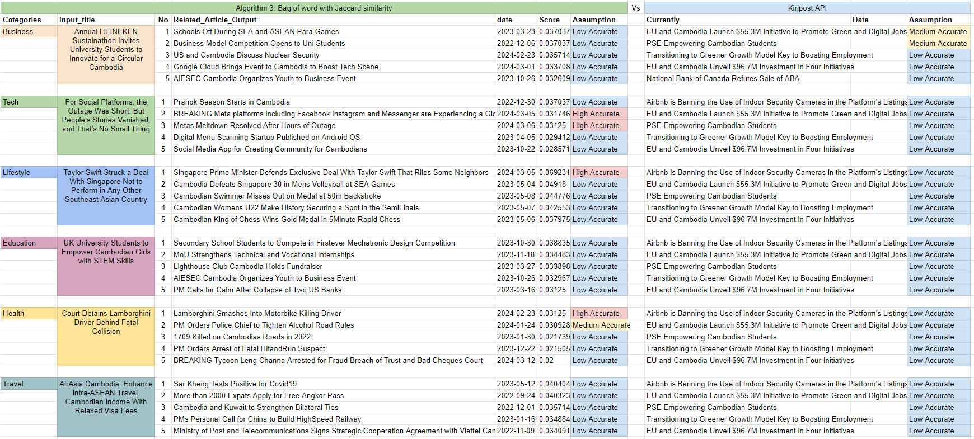
Result 3.2 of Bag of word with Jaccard similarity
High Accurate: 4, Medium Accurate: 1, Low Accuracy: 25

Slide 21
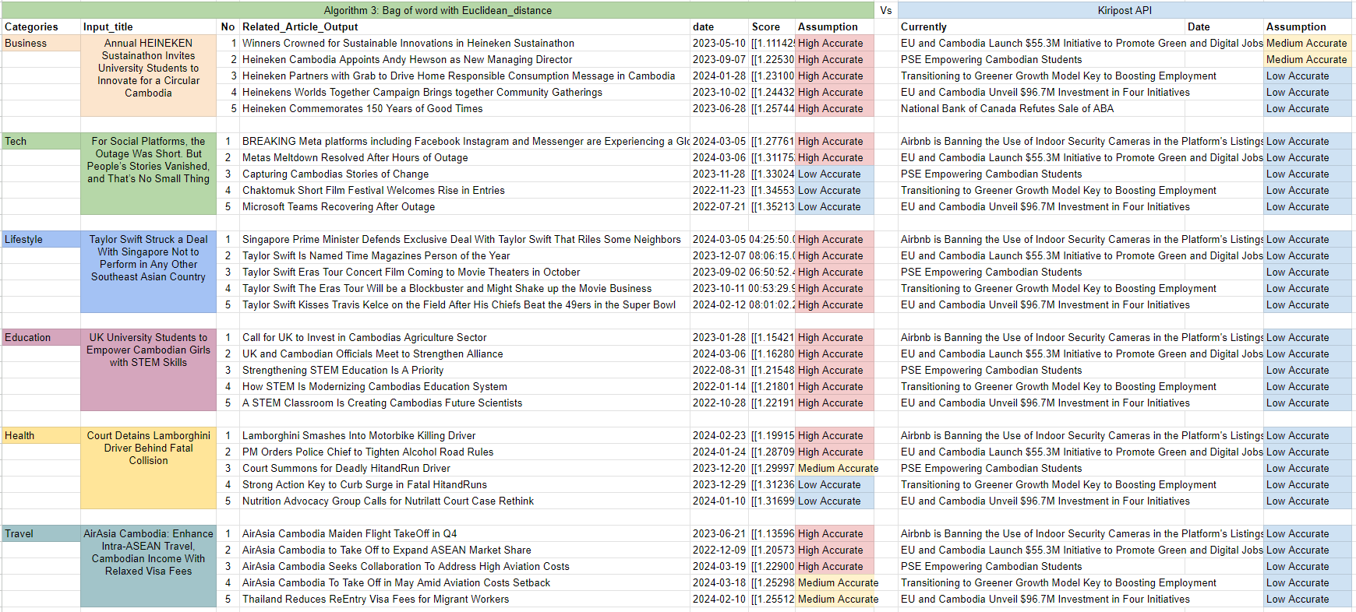
Result 3.3 of Bag of word with Euclidean distance
High Accurate: 22, Medium Accurate: 3, Low Accuracy: 5

Slide 22
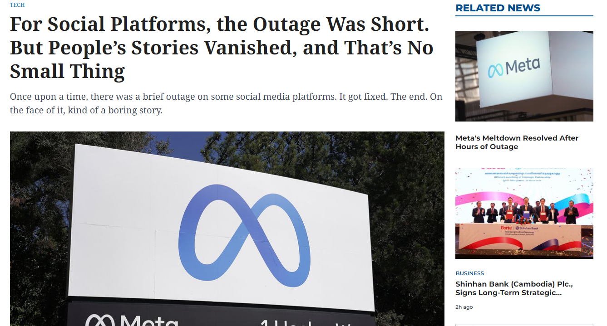
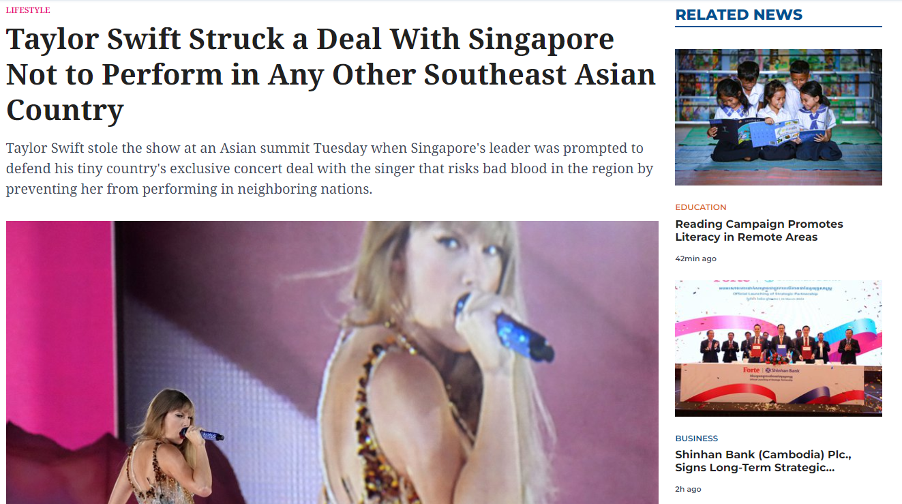

Word2vector on Kiripost Related News Model

Slide 23
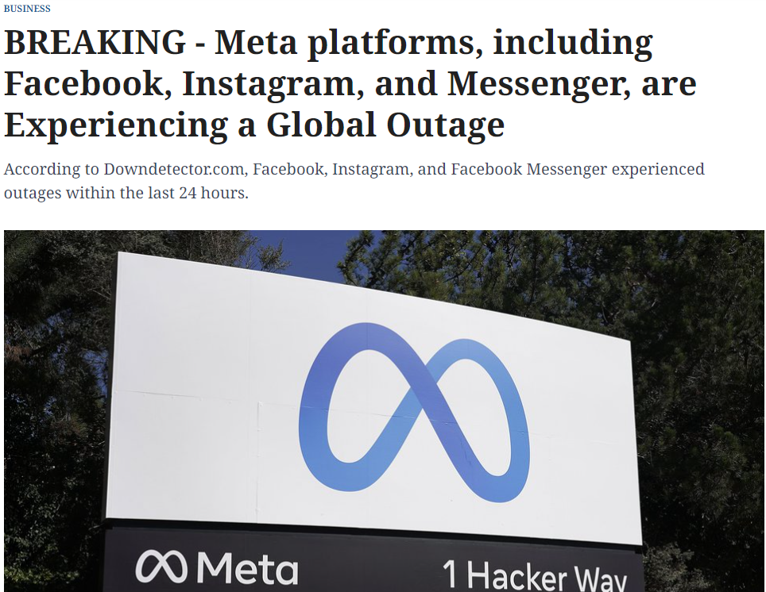

TF-IDF on Kiripost Related News Model

Slide 24
Comparison Algorithm
Characteristic | TF-IDF | Word2Vec | Bag of words
Semantic Accuracy | Moderate | High | Low
Context Sensitivity | Low | High | Low
Dimensionality Reduction | Not Applied | Applied | Not Applied
Vocabulary Sensitivity | High | Medium-High | Low-Medium
Pre-trained Models | No | Yes | No
Out-of-Vocabulary Handling | No | Yes | No
Interpretability | High | Low | High
Computational Complexity | Low | Medium-High | Low-Medium
Training Data Size | N/A | Large (Depends on Corpus) | N/A
Memory Usage | Low | High (Depends on Model Size) | Low
Suitable For | Small to Medium-Sized Corpora | Large Corpora | Small Corpora

Slide 25
Summarize Algorithm
Algorithm | similarity metrics | High Accurate | Medium Accurate | Low Accurate | Others
Word2Vector | Cosine Similarity | 0 | 2 | 28 | Current Algorithm on kiripost
TF-IDF | Cosine Similarity | 18 | 9 | 3 | Detect Importation word and transform word to TF-IDF vector and making similarity score, finally output similarity article
 | Jaccard similarity | 2 | 9 | 19
 | Euclidean Distance | 19 | 7 | 4
Word2Vector | Cosine Similarity | 1 | 0 | 29 | Tokens word to vectors and making Similarity
 | Jaccard similarity | 0 | 0 | 30
 | Euclidean Distance | 0 | 0 | 30
Bag of word | Cosine Similarity | 13 | 6 | 11 | Count word and sort then convert to vector and making Similarity
 | Jaccard similarity | 4 | 1 | 25
 | Euclidean Distance | 22 | 3 | 5

Slide 26
Matrix Accurate performance
Algorithm/similarity metrics | Cosine Similarity | Jaccard similarity | Euclidean Distance
TF-IDF | High Accurate | Low Accurate | High Accurate
Word2Vector | Low Accurate | Low Accurate | Low Accurate
Bag of word | High Accurate | Low Accurate | High Accurate

Slide 27
Comparison Computational
Algorithm | Accurate | Computational Time | Performance Search Related Article
TF-IDF | High Accurate | 4m 8s | ~1.7s
Word2Vector | Low Accurate | 19m 37s | ~1.8s
Bag of word | High Accurate | 3m 55s | ~2.5s

Slide 28
Conclusion
Kiripost leverages content recommendation systems:
optimize user experience
increase engagement
facilitate content discovery
drive revenue for online media platforms
benefiting both users and platform operators.
Our approach, utilizing algorithms like TF-IDF and Bag-of-Words (BoW) coupled with similarity metrics such as Cosine Similarity and Euclidean Distance, demonstrates higher accuracy compared to Word2Vec.

Slide 29



